Slide 1
Advanced LoRa Communication Systems
Presented by
Pintu Mondal (24CS4506)
Navnit Kumar (24CS4503)
Rakesh Kumar (24CS4507)
Narvdeshwar Kumar(24CS4515)

Slide 2
Problem Statement:
Transfer message using LoRa Full Duplex Communication (Chat) using Half Duplex Communication (Time, Text)

Slide 3
Introduction to LoRa
LoRa (Long Range) is a physical layer (PHY) wireless modulation technique that uses chirp spread spectrum technology to allow long-distance communication with low power consumption, typically used in IoT (Internet of Things) applications
Keys:-
Long Range – Can transmit data over 3–10 km in rural areas and 1–3 km in cities.
Low Power Consumption – Ideal for battery-operated IoT devices (lasting years on a single charge).
Low Data Rates – Typically 0.3–50 kbps, suitable for sensors and small data packets.
License-Free Frequency Bands – Operates in sub-GHz ISM bands (e.g., 868 MHz in Europe, 915 MHz in North America, 433 MHz in Asia).
Strong Penetration – Works well indoors and in challenging environments

Slide 4
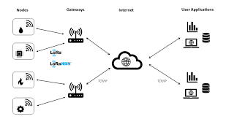
LoRa Architecture
LoRa communication follows a star-of-stars topology and is made up of four main components:
1.End Devices (Nodes)
2.Gateways
3.Network Server
4. Application Server

Slide 5
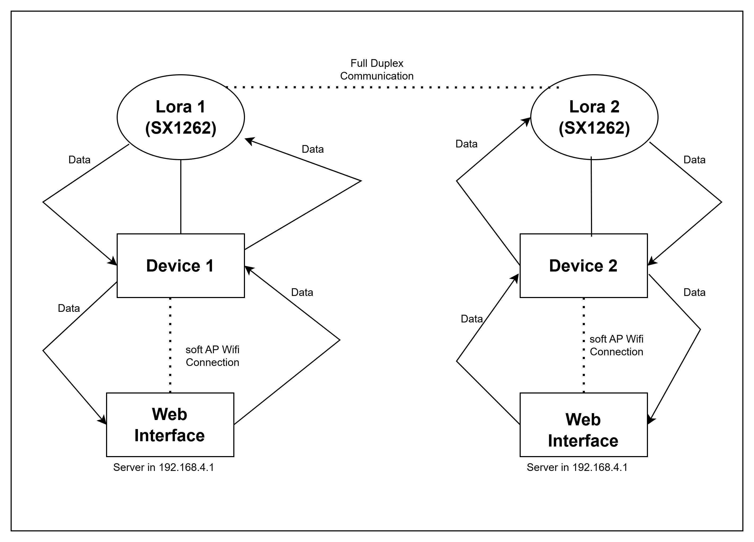
System Architecture

Slide 6
Channel Mapping
LoRa uses unlicensed ISM bands (e.g., 433 MHz, 868 MHz, 915 MHz)
Each band is divided into multiple channels
Channels are defined by center frequency and bandwidth (e.g., 125 kHz, 250 kHz)
Devices hop between channels using frequency hopping spread spectrum (FHSS)
Channel selection helps avoid interference and maximize capacity
LoRaWAN defines default channels (e.g., 3 fixed + dynamic in EU868)
Custom channel plans can be configured based on region and regulations

Slide 7
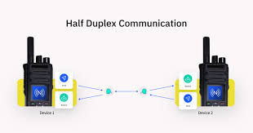
Half-Duplex Communication in LoRaWAN
Mechanism:
End devices transmit (uplink) → Gateway → Network Server.
Downlink possible only during receive windows (Class A/B/C).
Example: Temperature sensor sends data hourly; gateway replies with ACK.

Slide 8
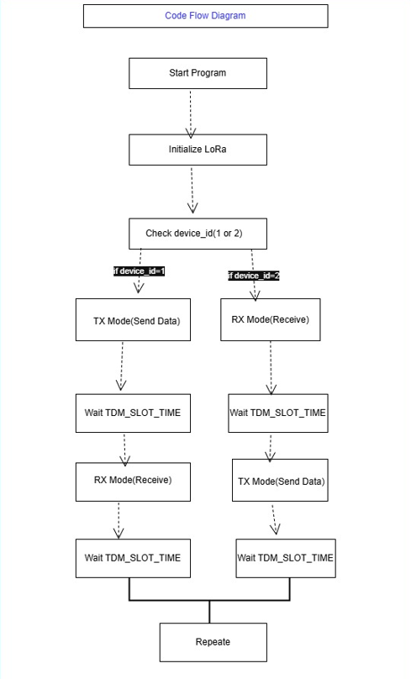

Slide 9
Full-Duplex Potential Using Half-Duplex
Concept: Dual-channel communication (theoretical in LoRa).
Use Case: Industrial automation with real-time control.

Slide 10
Stop-and-Wait Protocol
Basic Mechanism
Sender transmits one frame → Waits for ACK/NACK → Sends next frame.
Purpose
Ensures reliable data transfer in half-duplex LoRa networks.
Key Features
Flow Control: Only one frame in transit at a time.
Error Handling: Retransmits on timeout or NACK.
Low Complexity: Simple to implement in resource-constrained devices.

Slide 11
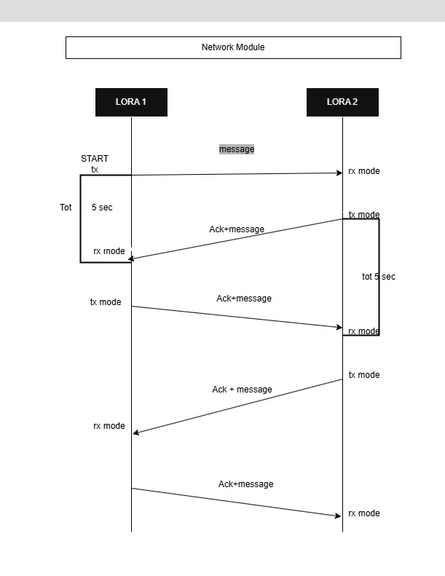

Slide 12
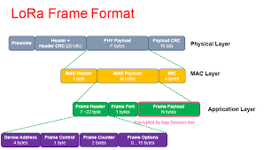
End-to-End Packet Journey
Preamble: 8 symbols for synchronization.
Header: CR (4/5–4/8), payload length.
Payload: Up to 255 bytes (application data).
CRC: 16-bit error check.

Slide 13
CSS with LoRa
Modulation: LoRa uses Chirp Spread Spectrum (CSS) for data encoding.
How it works:
Data → frequency-sweeping chirps (up/down)
Spreading Factor (SF7-SF12) adjusts range vs. speed
Why?
Long-range (15km+)
Low power (10+ years battery)
Noise-resistant (works in crowded RF environments)

Slide 14
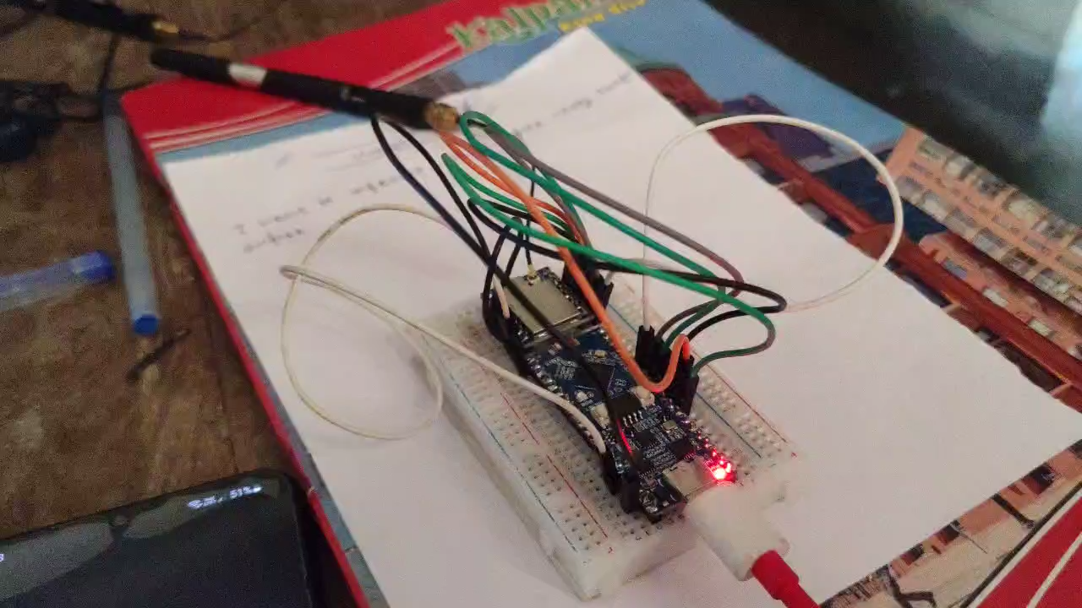
Video to show how the LoRa work in Our Laptop

Slide 15
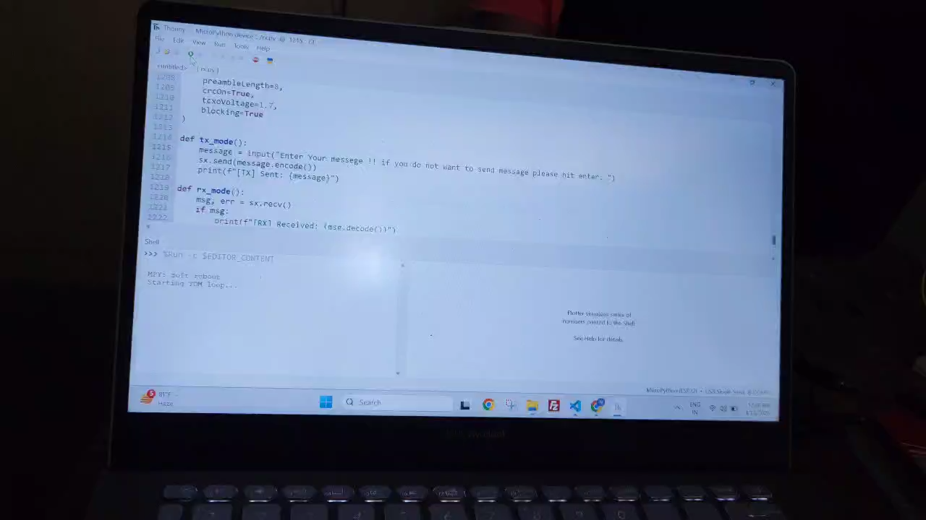

Slide 16
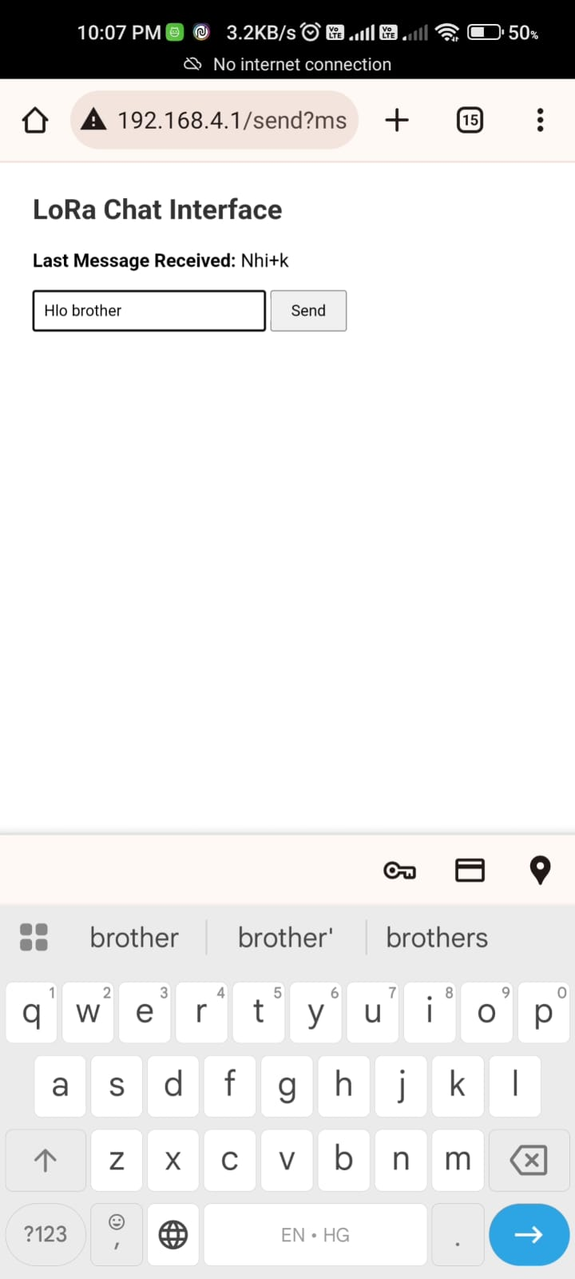
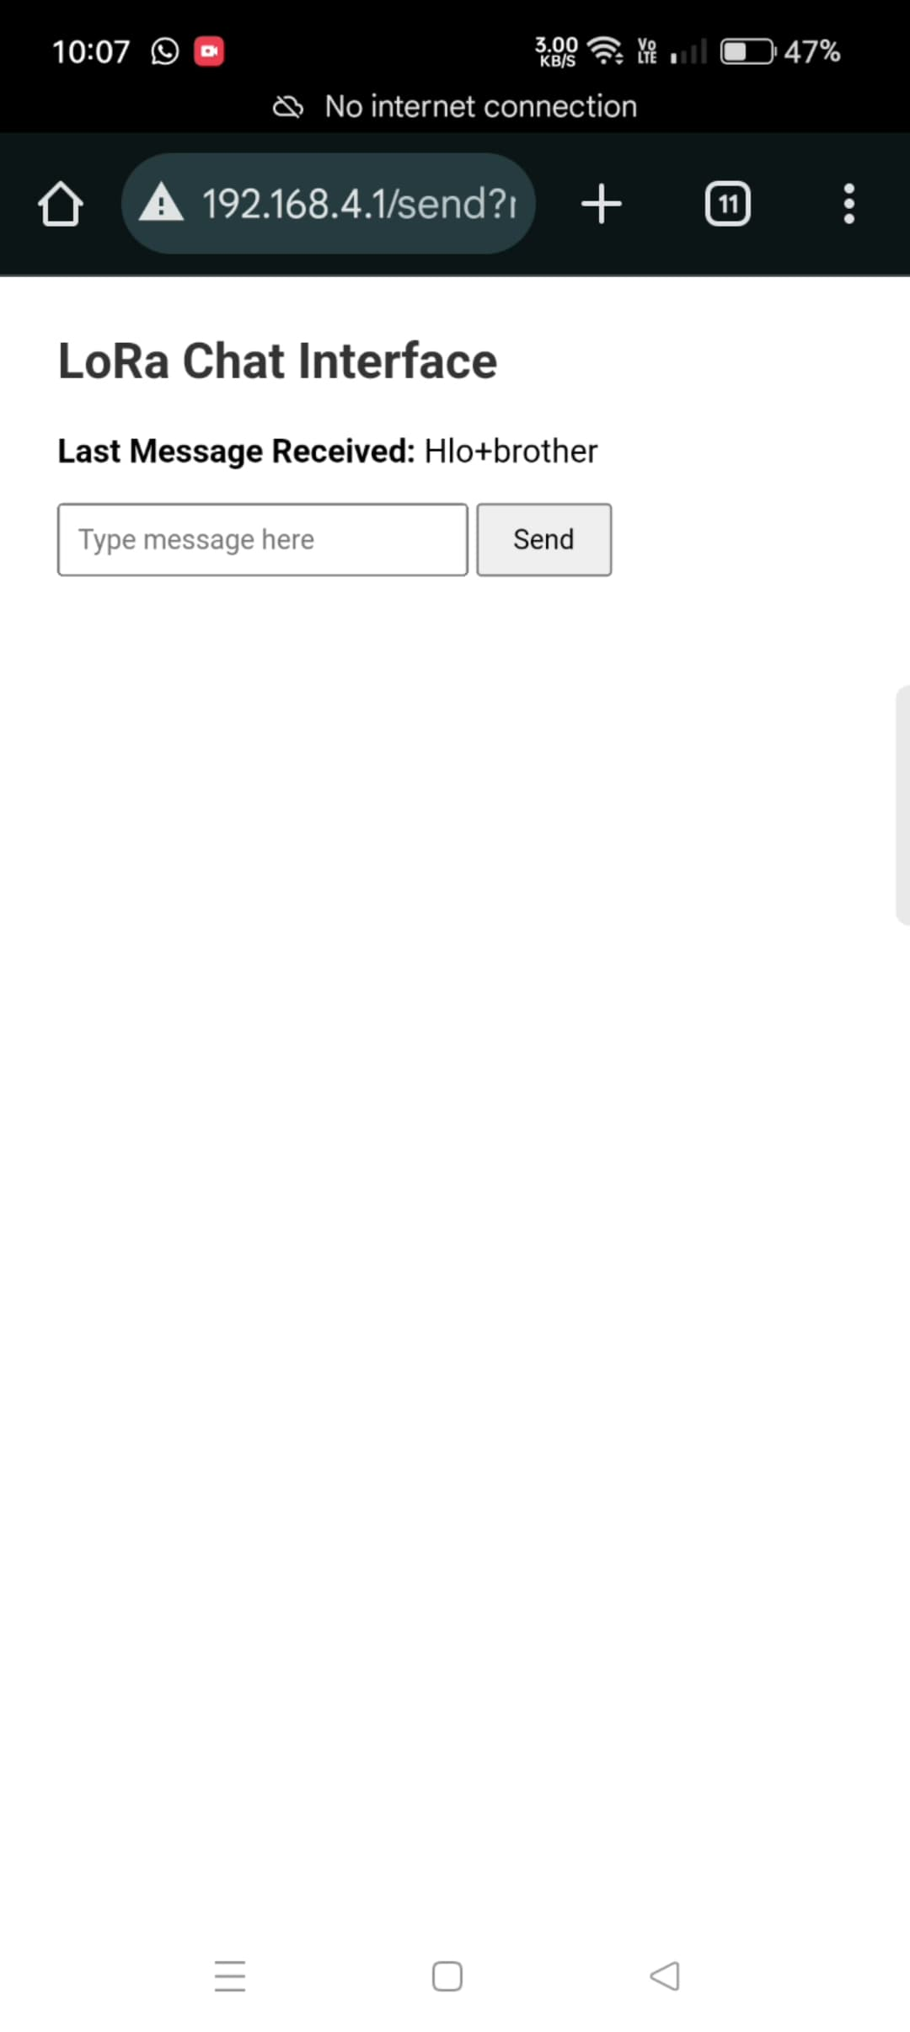
ScreenShots taken from mobile phone while messaging
Device-1 ScreenShots
Device-2 ScreenShots

Slide 17
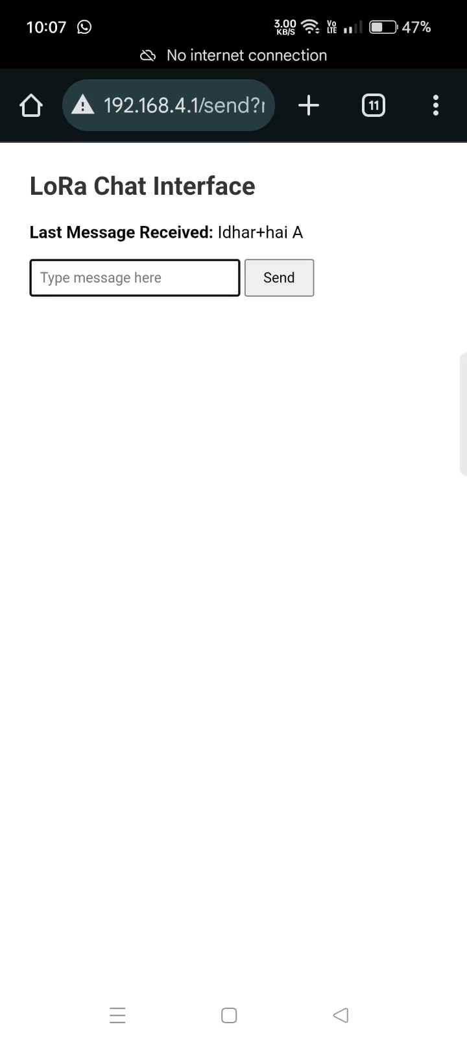
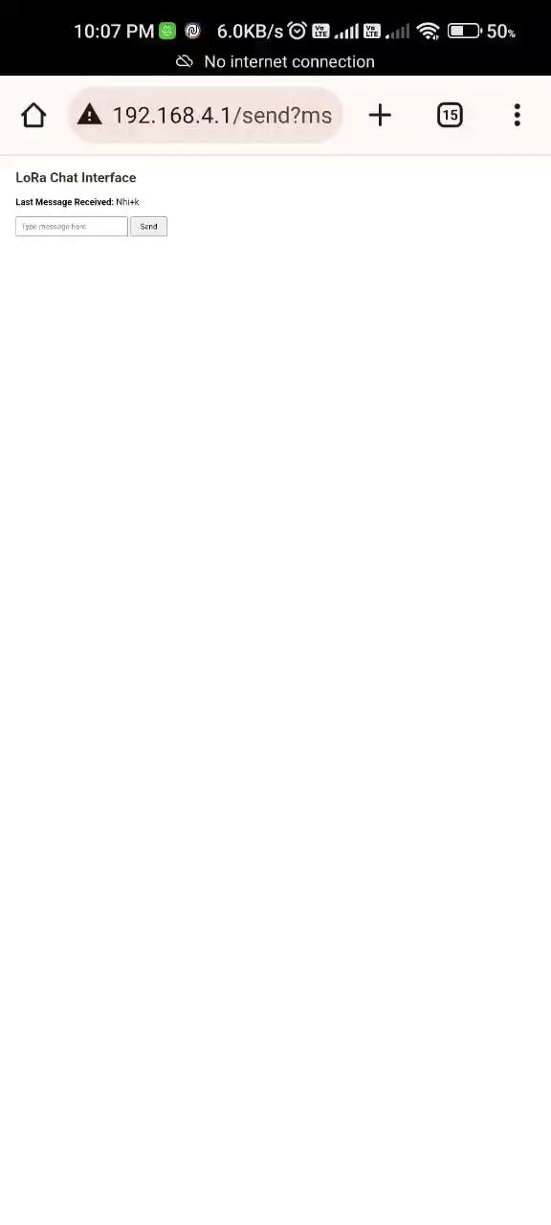

Slide 18
Conclusion
LoRa enables long-range, low-power IoT with CSS modulation.
SF trade-offs balance speed vs. range.
LoRaWAN/P2P modes suit diverse applications.
Ideal for noisy, remote environments.

Slide 19
Thank You
.

